Slide 1
Android Overview
CSE11
Mobile App Design and Development

Slide 2

Why Android?
Open Source
Rich Development Environment
Larger Developer and Community Reach
Higher Success Ratio
Increased Marketing
Reduced Cost of Development
Inter App Integration

Slide 3
Why Android? (cont.)
Open Source
Resources are freely available and may be redistributed and modified
Larger Developer and Community Reach
According to BusinessOfApps.com, in 2016, there were 12 million mobile app developers worldwide and more than half are Android developers
Increased Marketing
85.9% market share as of September 2018
Notes:
Open Source – Freely Available. There are no royalties when you use the technology. In contrast some closed-source mobile technologies are windows phone, iOS
Larger Developer and Community Reach

Slide 4
Why Android? (cont.)
Inter App Integration
Allows app to app interaction or dependencies (e.g. you may use your Facebook or Google account when creating an account in other applications)
Reduced Cost of Development
When making your own application, you may spend as low as $25 as a one-time payment for the use of Google Play
Notes:
Open Source – Freely Available. There are no royalties when you use the technology. In contrast some closed-source mobile technologies are windows phone, iOS
Larger Developer and Community Reach

Slide 5
Why Android? (cont.)
Higher Success Ratio
Software Applications Development has one of the best job projections for the next decade with a growth rate of 18.8%. According to these employment projections, there will be 135,300 new positions for App developers by the year 2024.
Rich Development Environment
Being open-source, the community of developers continuously contribute to the body of knowledge
Notes:
Open Source – Freely Available. There are no royalties when you use the technology. In contrast some closed-source mobile technologies are windows phone, iOS
Larger Developer and Community Reach

Slide 6
Features
Beautiful UI
Android OS basic screen provides a beautiful and intuitive user interface.
Connectivity
GSM/EDGE, Bluetooth, Wi-Fi, LTE, NFC, WiMAX and others
Storage
SQLite, a lightweight relational database, is used for data storage purposes.
Media support
H.263, H.264, MPEG-4 SP, AMR, AMR-WB, AAC, HE-AAC, AAC 5.1, MP3, MIDI, Ogg Vorbis, WAV, JPEG, PNG, GIF, and BMP.
Notes:
Discussion Points:
1. Mobile - Kinds and examples of mobile devices
2. Mobile Applications – Categories and examples of mobile applications
Purposes of each the categories
Benefits of using mobile applications as opposed to a web or desktop application
3. Design Vs Development, difference and how it overlaps

Slide 7
Features (cont.)
Messaging
SMS and MMS
Web browser
Based on the open-source WebKit layout engine, coupled with Chrome's V8 JavaScript engine supporting HTML5 and CSS3.
Multi-touch
Android has native support for multi-touch which was initially made available in handsets such as the HTC Hero.
Multi-tasking
User can jump from one task to another and same time various application can run simultaneously.
Notes:
Discussion Points:
1. Mobile - Kinds and examples of mobile devices
2. Mobile Applications – Categories and examples of mobile applications
Purposes of each the categories
Benefits of using mobile applications as opposed to a web or desktop application
3. Design Vs Development, difference and how it overlaps

Slide 8
Features (cont.)
Resizable widgets
Widgets are resizable, so users can expand them to show more content or shrink them to save space.
Multi-Language
Supports single direction and bi-directional text.
GCM
Google Cloud Messaging (GCM) is a service that lets developers send short message data to their users on Android devices, without needing a proprietary sync solution.
Wi-Fi Direct
A technology that lets apps discover and pair directly, over a high-bandwidth peer-to-peer connection.
Notes:
Discussion Points:
1. Mobile - Kinds and examples of mobile devices
2. Mobile Applications – Categories and examples of mobile applications
Purposes of each the categories
Benefits of using mobile applications as opposed to a web or desktop application
3. Design Vs Development, difference and how it overlaps

Slide 9
Features (cont.)
Android Beam
A popular NFC-based technology that lets users instantly share, just by touching two NFC-enabled phones together.
Notes:
Discussion Points:
1. Mobile - Kinds and examples of mobile devices
2. Mobile Applications – Categories and examples of mobile applications
Purposes of each the categories
Benefits of using mobile applications as opposed to a web or desktop application
3. Design Vs Development, difference and how it overlaps

Slide 10
Android Applications
Android applications are usually developed in the Java language using the Android Software Development Kit (SDK).
Once developed, Android applications can be packaged easily and sold out through application stores such as Google Play

Slide 11





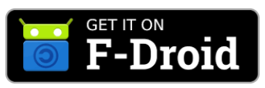
Android App Stores

Slide 12
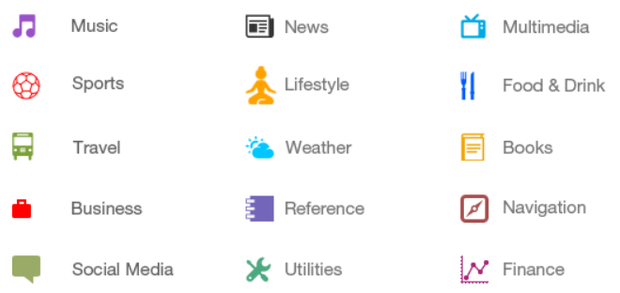
Android App Categories

Slide 13
Android Versions

Slide 14
Android Version History
Android versions are named after desserts (e.g. Kitkat, Donut, Jelly Bean)
Each version corresponds to different API Levels
API stands for Application Program Interface
API Level is an integer value that uniquely identifies the framework API revision offered by a version of the Android platform.

Slide 15

Android Version History
Early Versions
Version | Code Name | Release Date | API Level
1.0 | Apple Pie | September 23, 2008 | 1
1.1 | Petit Four/Banana Bread | February 9, 2009 | 2
1.5 | Cupcake | April 27, 2009 | 3

Slide 16
Android Version History (cont.)
Android 1.0 – Apple Pie
Download and updates via Android Market
Web Browser
Camera support
Gmail, Contacts and Google Agenda synchronization
Google Maps
YouTube application

Slide 17
Android Version History (cont.)
Android 1.1 – Banana Bread
"Show" & "Hide" numeric keyboard, in caller application
Ability to save MMS attachments

Slide 18
Android Version History (cont.)
Android 1.5 – Cupcake
Bluetooth A2DP, AVRCP support
Soft-keyboard with text-prediction
Record/watch videos

Slide 19
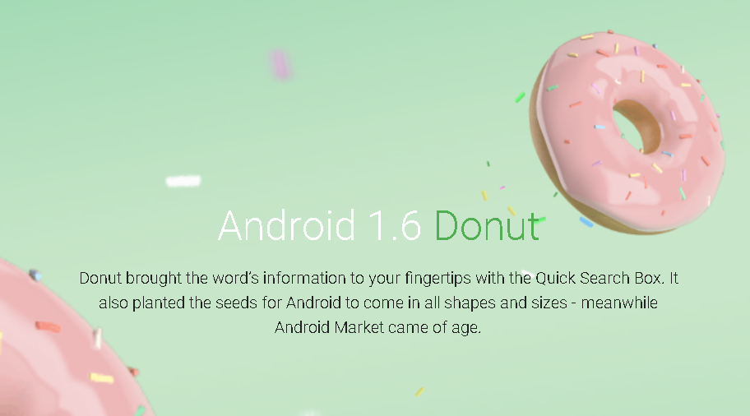
Android Version History (cont.)
API 4
September 15, 2009

Slide 20
Android Version History (cont.)
Android 1.6 – Donut
Gesture framework
Turn-by-turn navigation

Slide 21
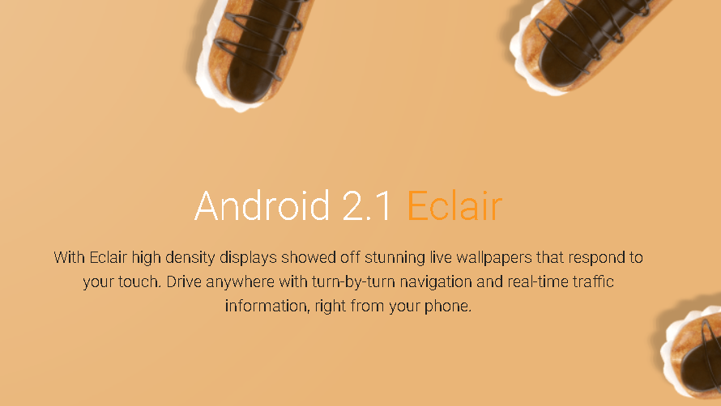
Android Version History (cont.)
API 5-7
October 26, 2009

Slide 22
Android Version History (cont.)
Android 2.2 – Eclair
HTML
Digital zoom
Microsoft Exchange support
Bluetooth 2.1
Live Wallpapers
Updated UI

Slide 23
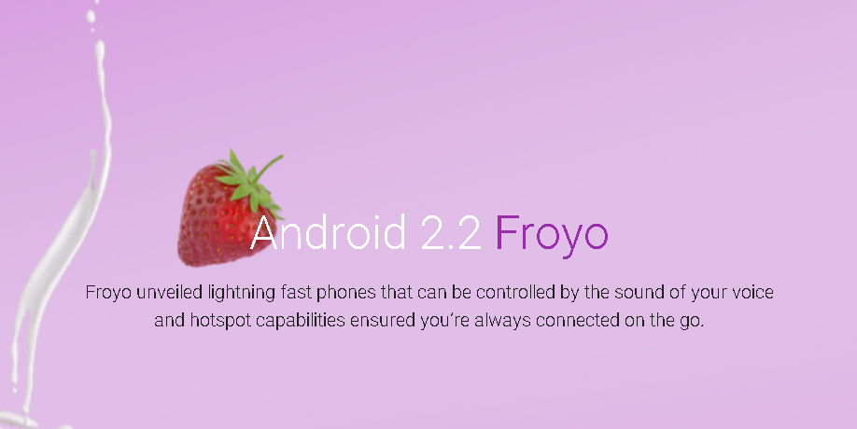
Android Version History (cont.)
API 8
May 20, 2010

Slide 24
Android Version History (cont.)
Android 2.2 – Froyo
Speed improvements
JIT implementation
USB Tethering
Applications installation to the expandable memory
Upload file support in the browser
Animated GIFs

Slide 25
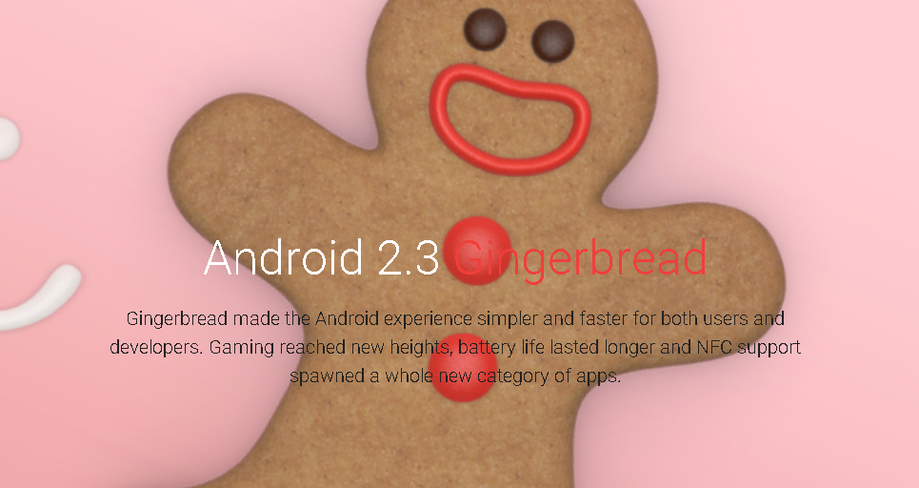
Android Version History (cont.)
API 9-10
December 6, 2010

Slide 26
Android Version History (cont.)
Android 2.3 – Gingerbread
Updated UI
Improved keyboard ease of use
Improved copy/paste
Improved power management
Social networking features
Near Field Communication support
Native VoIP/SIP support
Video call support

Slide 27
Android Version History (cont.)
Android 2.3.4 – Gingerbread
Voice or video chat using Google Talk
Android 2.3.5 – Gingerbread
Improved network performance for the Nexus S 4G
Fixed Bluetooth issues on the Samsung Galaxy S
Gmail app. Improvements
Android 2.3.6 – Gingerbread
Voice search issue fixed
Android 2.3.7 – Gingerbread
Google Wallet support for the Nexus S 4G

Slide 28
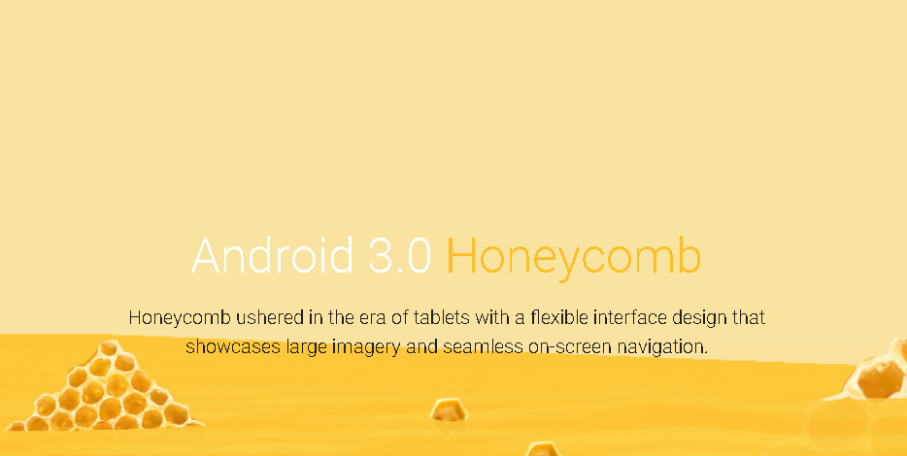
Android Version History (cont.)
API 11-13
February 22, 2011

Slide 29
Android Version History (cont.)
Android 3.0 – Honeycomb
Multi core support
Better tablet support
Updated 3D UI
customizable homescreens
recent applications viewing
redone keyboard layout
Media/Picture transport protocol
Google Talk video chat
Google eBooks
"Private browsing"
System-wide Clipboard
HTTP Live streaming

Slide 30
Android Version History (cont.)
Android 3.1 – Honeycomb
UI improvements
Open Accessory API
USB host API
Mice, joysticks, gamepads... support
Resizable Home screen widgets
MTP notifications
RTP API for audio

Slide 31
Android Version History (cont.)
Android 3.2 – Honeycomb
Optimizations for a wider range of tablets
Compatibility display mode (zoom for fixed-sized apps)
Media sync from SD card
Android 3.2.1 – Honeycomb
Android Market updates including easier automatic updates
Google Books updates
Wi-Fi improvements
Chinese handwriting prediction improved

Slide 32
Android Version History (cont.)
Android 3.2.2 – Honeycomb
Minor fixes
Android 3.2.4 – Honeycomb
Added "Pay as you go" for tablets

Slide 33
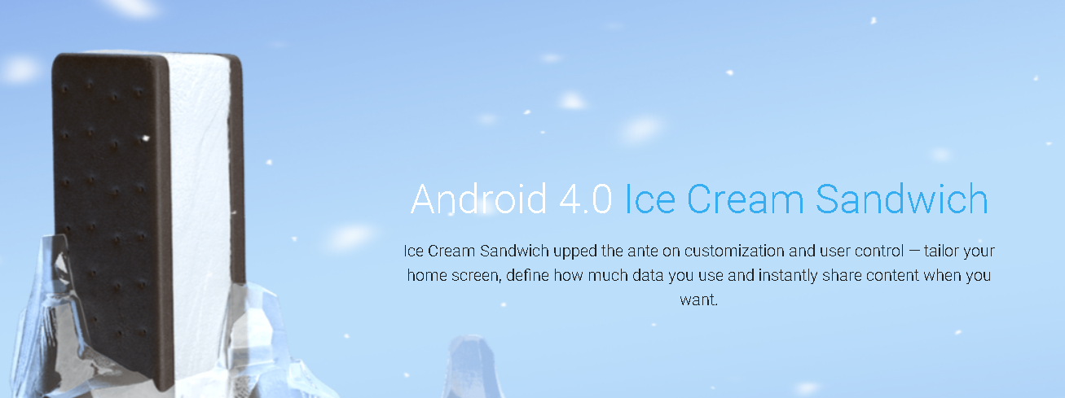
Android Version History (cont.)
API 14-15
October 18, 2011

Slide 34
Android Version History (cont.)
Android 4.0 – Ice Cream Sandwich
New lock screen actions
Improved text input and spell-checking
Control over network data
Email app supports EAS v14
WI-FI direct
BlueTooth Health Device Profile

Slide 35
Android Version History (cont.)
Android 4.0.1 – Ice Cream Sandwich
Facial recognition (Face Unlock)
UI use Hardware acceleration
Better voice recognition (dictating/Voice typing)
Web browser, allows up to 16 tabs
Updated launcher (customizable)
Android Beam app to exchange data through NFC
Android 4.0.2 – Ice Cream Sandwich
Minor fixes

Slide 36
Android Version History (cont.)
Android 4.0.3 – Ice Cream Sandwich
Social stream API in Contacts provider to show updates associated to your contacts
Video stabilization and QVGA video resolution API access
Accessibility API refinements for screen readers
Calendar provider updates
Android 4.0.4 – Ice Cream Sandwich
stability improvements
better camera performance
smoother screen rotation

Slide 37
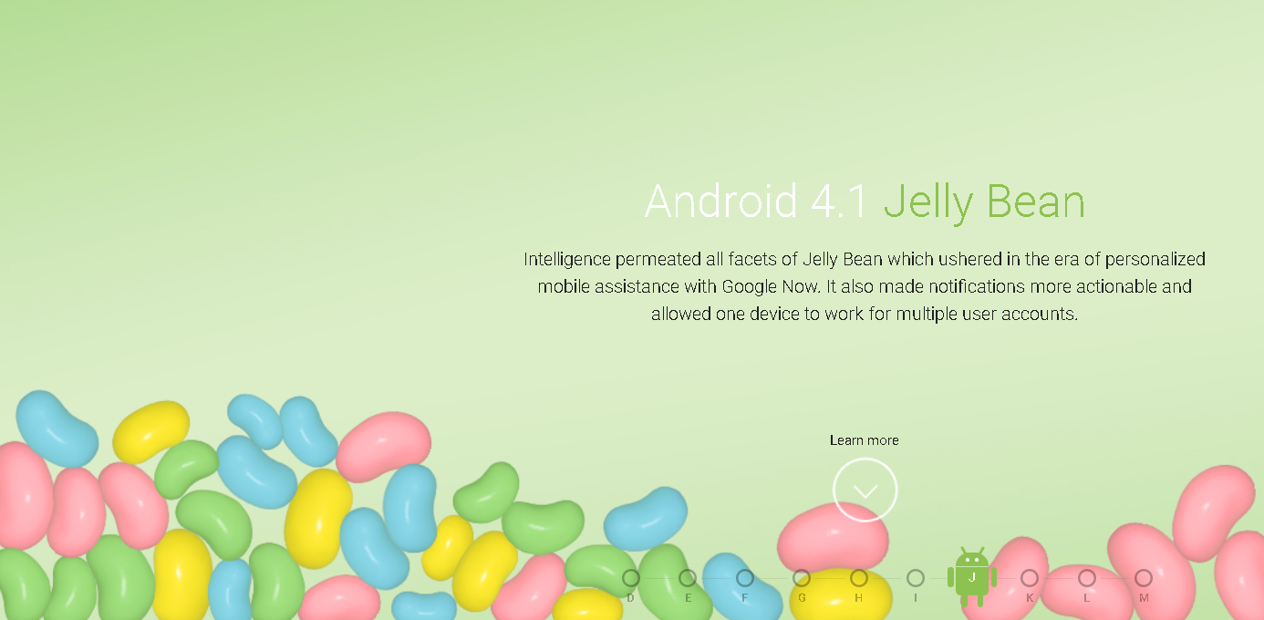
Android Version History (cont.)
API 16-17
July 9, 2012

Slide 38
Android Version History (cont.)
Android 4.1 – Jelly Bean
Google Now
Voice Search
Speed enhancements
Camera app improvements
Accessibility: gesture mode, enable braille external keyboards
Android 4.1 – Jelly Bean
Fix a bug on screen orientation
Android 4.2 – Jelly Bean
Enable Home screen rotation
Fix bugs and enhance performances

Slide 39
Android Version History (cont.)
Android 4.2 – Jelly Bean
Lockscreen widgets
360 degree images with Photo Sphere
Gesture Typing, for faster typing
Wireless display with Miracast
Daydream to display information when idle or docked
Multi-user for tablets
Android 4.2.1 – Jelly Bean
Fix missing december bug in the People app
Add support for Bluetooth gamepads and joysticks HID devices

Slide 40
Android Version History (cont.)
Android 4.2.2 – Jelly Bean
Allow toggling Wi-Fi and Bluetooth state in Quick Settings using long-press
Shows the percentage and estimated time remaining in the active download notifications
Wireless charging and low battery sounds changed
Gallery app updated for faster loading with new image transition
Performance enhancements and bug fixes (Bluetooth A2DP audio streaming fix...)

Slide 41
Android Version History (cont.)
Android 4.3– Jelly Bean
Dial pad auto-complete
Photo Sphere enhancements
Camera app UI updated
4K resolution support
Ability to create restricted profiles for tablets
Hebrew and Arabic right-to-left (RTL) support
Bluetooth Low Energy (BLE) support
Bluetooth Audio/Video Remote Control Profile (AVRCP) 1.3 support
Security and performance enhancements

Slide 42

Android Version History (cont.)
API 19-20
October 31, 2013

Slide 43
Android Version History (cont.)
Android 4.4 - Kitkat
Screen recording
New Translucent system UI
Enhanced notification access
System-wide settings for closed captioning
Performance improvements
Android 4.4.1 - Kitkat
Bug fixes
Enhance the camera on the Nexus 5

Slide 44
Android Version History (cont.)
Android 4.4.2 - Kitkat
Bug fixes
Security enhancements
Android 4.4.3- Kitkat
Bug fixes
Enable Sprint Spark band 26 and band 41
Android 4.4.4- Kitkat
Fix Heartbleed / OpenSSL vulnerability

Slide 45

Android Version History (cont.)
API 22-22
November 12, 2014

Slide 46
Android Version History (cont.)
Android 5.0 - Lollipop
New design (Material design)
Speed improvement
Battery consumption improvement
Android 5.0.1 - Lollipop
bug fixes, fix issues with video playback and password failures
Android 5.0.1 - Lollipop
Performance improvements and bug fixes

Slide 47
Android Version History (cont.)
Android 5.1 – Lollipop
Multiple SIM cards support
Quick settings shortcuts to join Wi-Fi networks or control Bluetooth devices
Lock protection if lost or stolen
High Definition voice call
Stability and performance enhancements
Android 5.1.1 – Lollipop
Speed improvement
Bug fixes

Slide 48
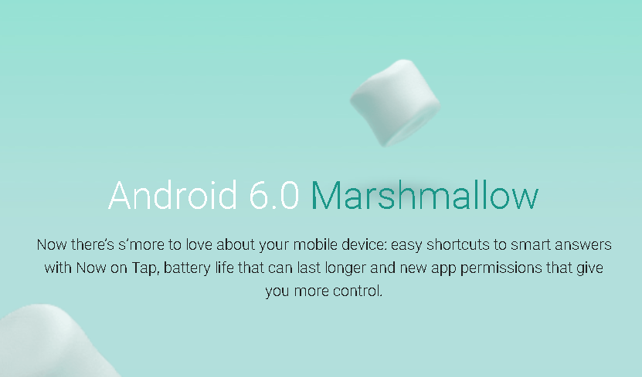
Android Version History (cont.)
API 23
October 5, 2015

Slide 49
Android Version History (cont.)
Android 6 - Marshmallow
USB Type-C support
Fingerprint Authentication support
Better battery life with "deep sleep"
Permissions dashboard
Android Pay
MIDI support
Google Now improvements
New emojis

Slide 50
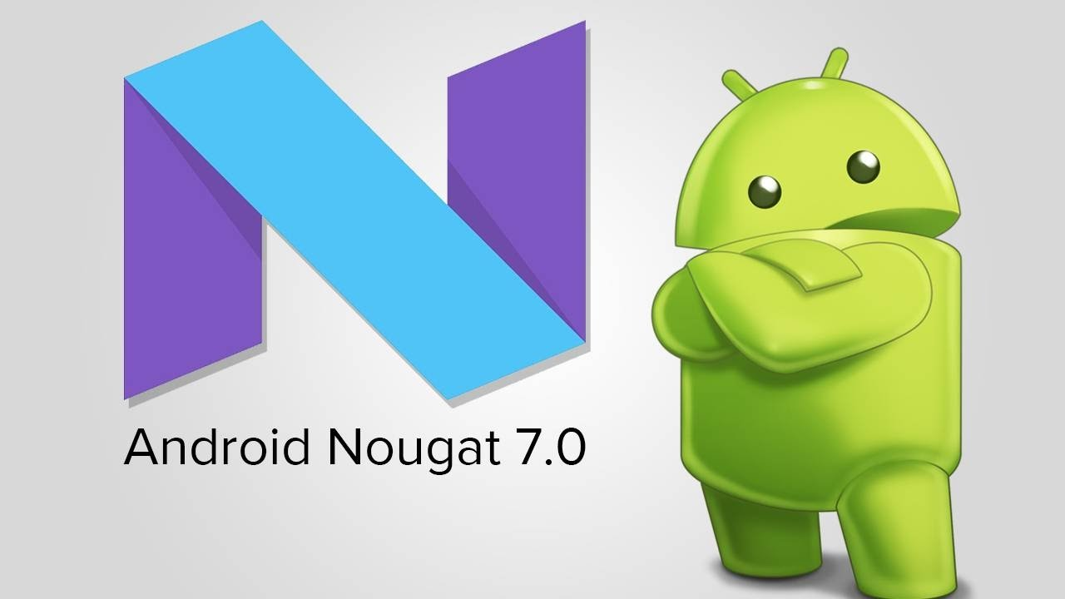
Android Version History (cont.)
API 24 -25
August 22, 2016

Slide 51
Android Version History (cont.)
Android 7.0 - Nougat
Unicode 9.0 emoji
Better multitasking
Multi-window mode (PIP, Freeform window)
Seamless system updates (with dual system partition)
Better performance and code size thanks to new JIT Compiler

Slide 52
Android Version History (cont.)
Android 7.1 - Nougat
Daydream Virtual Reality mode
Night Light
Storage manager improvements
Performance improvements for Touch and Display managements
Option to enable fingerprint swipe down gesture
Seamless system updates

Slide 53
Android Version History (cont.)
Android 7.1.1 - Nougat
Long press on the app icon enable new launch actions
The default keyboard allows now to send GIFs directly
New set of emojis
Android 7.1.2 - Nougat
Battery usage alerts
Nexus and Pixel specific improvements

Slide 54
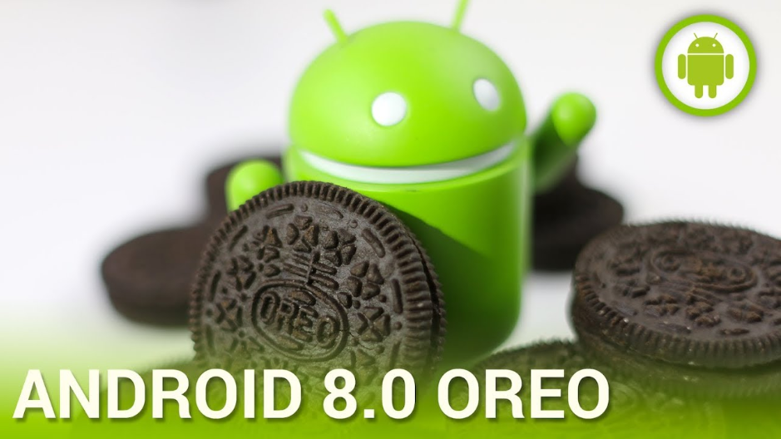
Android Version History (cont.)
API 26 -27
August 21, 2017

Slide 55
Android Version History (cont.)
Android 8 - Oreo
Show battery level in "Quick Settings" for devices connected via Bluetooth
Navigation buttons dim when not in use
UI updates to 'Power Off' and 'Restart'
Toast messages are now white in color with same existing transparency
Automatic light and dark themes
Emoji updates (ie: Hamburger move the cheese slice position)

Slide 56
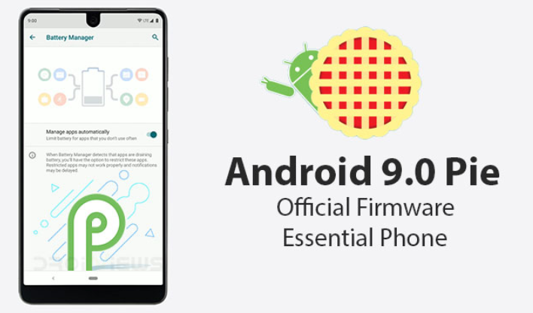
Android Version History (cont.)
API 28
August 6, 2018

Slide 57
Android Version History (cont.)
Android 9 - Pie
User interface updates:
Rounded corners across the UI
Quick settings menu change.
Notification bar, the clock has moved to the left.
The "dock" now has a semi-transparent background.
New transitions when switching between apps, or within apps
Volume slider updated
Richer messaging notifications: with full conversation, large images, smart replies
The power options now has a "screenshot" button
Biometric authentication can now be disabled only once

Slide 58
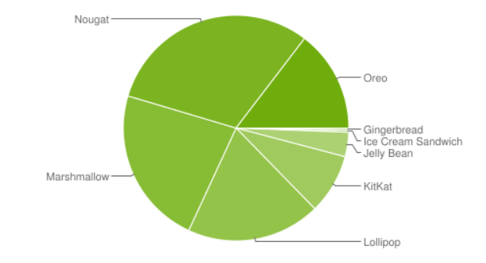
Android Version Distribution
Android Version Distribution Share as of September 12, 2018

Slide 59
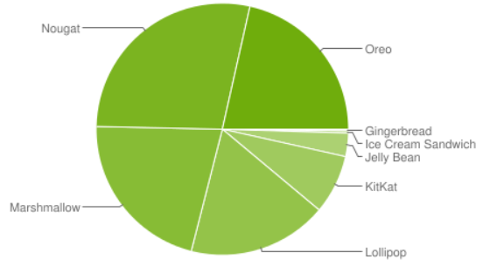
Android Version Distribution
Android Version Distribution Share as of May 2, 2019

Slide 60
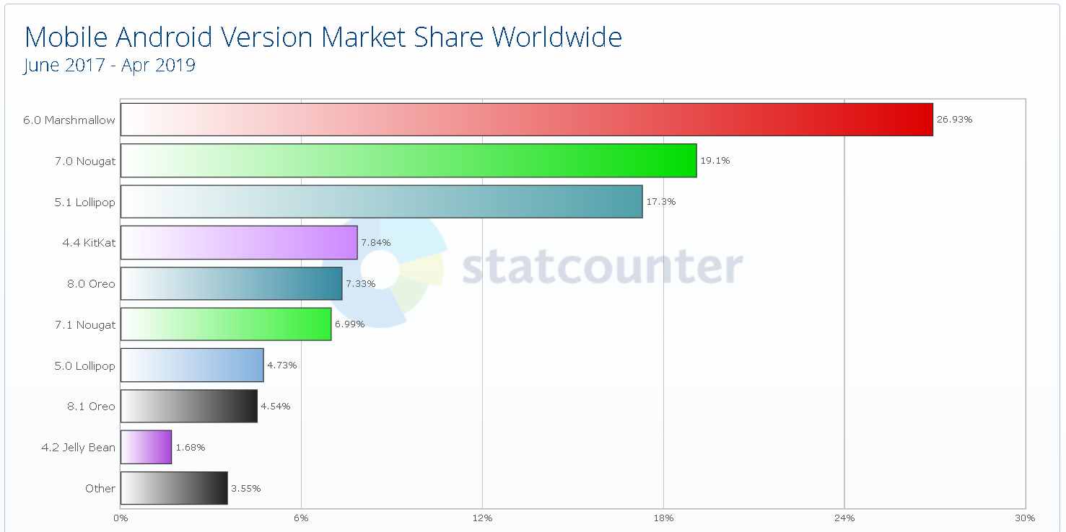
Android Version Distribution

Slide 61
Android Architecture

Slide 62
Android Architecture
Android operating system is a stack of software components which is roughly divided into five sections and four main layers as shown below in the architecture diagram.
The five sections are:
Linux Kernel
Libraries
Android Runtime
Application Framework
Applications

Slide 63
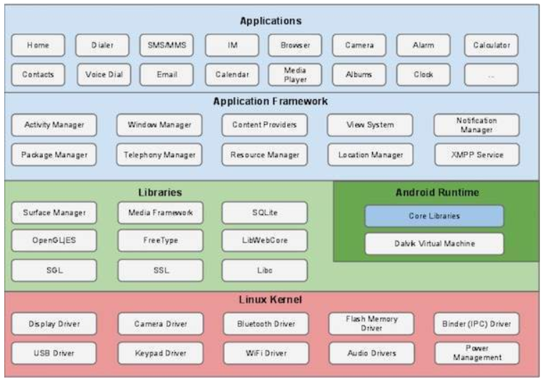
Android Architecture (cont.)
Android Architecture Diagram

Slide 64
Android Architecture (cont.)
Linux kernel
At the bottom of the layers is Linux - Linux 3.6 with approximately 115 patches.
It provides a level of abstraction between the device hardware and it contains all the essential hardware drivers like camera, keypad, display etc.
The kernel also handles all the things that Linux is really good at such as networking and a vast array of device drivers, which take the pain out of interfacing to peripheral hardware.

Slide 65
Android Architecture (cont.)
Libraries
On top of Linux kernel there is a set of libraries including:
open-source Web browser engine WebKit
well known library libc
SQLite database which is a useful repository for storage and sharing of application data
libraries to play and record audio and video
SSL libraries responsible for Internet security etc.

Slide 66
Android Libraries
Java-based libraries:
android.app − Provides access to the application model and is the cornerstone of all Android applications.
android.content − Facilitates content access, publishing and messaging between applications and application components.
android.database − Used to access data published by content providers and includes SQLite database management classes.
android.opengl − A Java interface to the OpenGL ES 3D graphics rendering API.
Notes:
Examples of libraries in this category include the application framework libraries in addition to those that facilitate user interface building, graphics drawing and database access. A summary of some key core Android libraries available to the Android developer is as follows −

Slide 67
Android Libraries (cont.)
android.os − Provides applications with access to standard operating system services including messages, system services and inter-process communication.
android.text − Used to render and manipulate text on a device display.
android.view − The fundamental building blocks of application user interfaces.
android.widget − A rich collection of pre-built user interface components such as buttons, labels, list views, layout managers, radio buttons etc.
android.webkit − A set of classes intended to allow web-browsing capabilities to be built into applications.
Notes:
Examples of libraries in this category include the application framework libraries in addition to those that facilitate user interface building, graphics drawing and database access. A summary of some key core Android libraries available to the Android developer is as follows −

Slide 68
Android Architecture (cont.)
Android Runtime
This is the third section of the architecture and available on the second layer from the bottom. This section provides a key component called Dalvik Virtual Machine which is a kind of Java Virtual Machine specially designed and optimized for Android.
The Dalvik VM makes use of Linux core features like memory management and multi-threading, which is intrinsic in the Java language. The Dalvik VM enables every Android application to run in its own process, with its own instance of the Dalvik virtual machine.

Slide 69
Android Architecture (cont.)
Android Runtime
The Android runtime also provides a set of core libraries which enable Android application developers to write Android applications using standard Java programming language.

Slide 70
Android Architecture (cont.)
Application Framework
The Application Framework layer provides many higher-level services to applications in the form of Java classes.
Application developers are allowed to make use of these services in their applications.

Slide 71
Android Architecture (cont.)
Application Framework - includes the following key services:
Activity Manager − Controls all aspects of the application lifecycle and activity stack.
Content Providers − Allows applications to publish and share data with other applications.
Resource Manager − Provides access to non-code embedded resources such as strings, color settings and user interface layouts.
Notifications Manager − Allows applications to display alerts and notifications to the user.
View System − An extensible set of views used to create application user interfaces.

Slide 72
Android Architecture (cont.)
Application Framework - includes the following key services:
Activity Manager − Controls all aspects of the application lifecycle and activity stack.
Content Providers − Allows applications to publish and share data with other applications.
Resource Manager − Provides access to non-code embedded resources such as strings, color settings and user interface layouts.
Notifications Manager − Allows applications to display alerts and notifications to the user.
View System − An extensible set of views used to create application user interfaces.

Slide 73
Android Architecture (cont.)
Applications
You will find all the Android application at the top layer.
User Applications are installed on this layer only.
Examples of such applications are Contacts Books, Browser, Games etc.

Slide 74
Application Components

Slide 75
Application Components
Application components are the essential building blocks of an Android application. These components are loosely coupled by the application manifest file AndroidManifest.xml that describes each component of the application and how they interact.
There are following four main components that can be used within an Android application
Activities
Services
Broadcast Receivers
Content Providers

Slide 76
Application Components (cont.)
Component | Description
Activities | They dictate the UI and handle the user interaction to the smart phone screen.
Broadcast Receivers | They handle communication between Android OS and applications.
Content Providers | They handle data and database management issues.
Services | They handle background processing associated with an application.

Slide 77
Application Components (cont.)
Activities
An activity represents a single screen with a user interface,
In-short Activity performs actions on the screen.
For example, an email application might have one activity that shows a list of new emails, another activity to compose an email, and another activity for reading emails.
If an application has more than one activity, then one of them should be marked as the activity that is presented when the application is launched.

Slide 78
Application Components (cont.)
Broadcast Receivers
Broadcast Receivers simply respond to broadcast messages from other applications or from the system.
For example, applications can also initiate broadcasts to let other applications know that some data has been downloaded to the device and is available for them to use, so this is broadcast receiver who will intercept this communication and will initiate appropriate action.

Slide 79
Application Components (cont.)
Content Providers
A content provider component supplies data from one application to others on request.
Such requests are handled by the methods of the ContentResolver class.
The data may be stored in the file system, the database or somewhere else entirely.

Slide 80
Application Components (cont.)
Services
A service is a component that runs in the background to perform long-running operations.
For example, a service might play music in the background while the user is in a different application, or it might fetch data over the network without blocking user interaction with an activity.

Slide 81
Application Components (cont.)
Additional Components
Fragments - Represents a portion of user interface in an Activity.
Views - UI elements that are drawn on-screen including buttons, lists forms etc.
Layouts - View hierarchies that control screen format and appearance of the views.
Intents – Messages wiring components together.
Resources - External elements, such as strings, constants and drawable pictures.
Manifest - Configuration file for the application.

Slide 82
Sources
Tutorials Point https://www.tutorialspoint.com/android/
Android https://www.android.com/history; https://developer.android.com/about/dashboards/

